Slide 1
YOLO the most famous computer vision architecture
Bekenova Aruzhan

Slide 2
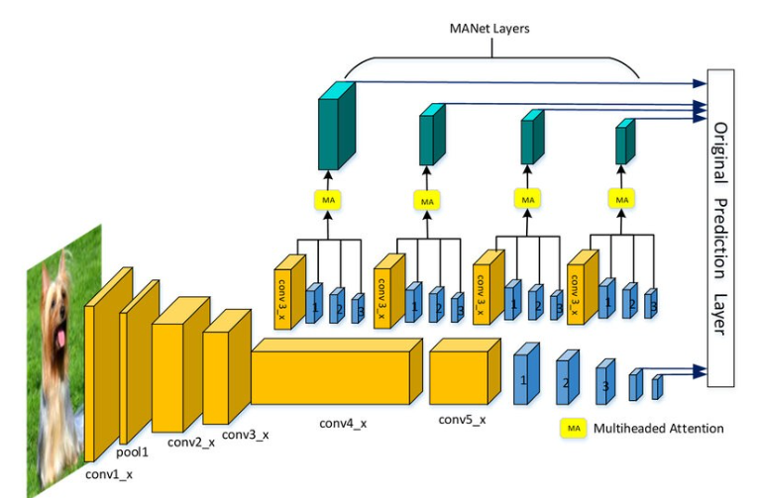
YOLO is a single-shot object detection architecture that predicts bounding boxes and class probabilities directly from an input image. It processes the entire image in one forward pass, making it efficient for real-time applications.
Single Shot Detection Architecture

Slide 3
YOLOv8 gained popularity due to the balance between speed and accuracy. It provides faster data output and supports real-time performance, making it suitable for applications requiring low latency. Users can train it on specific classes of objects related to their application.
Advanced Capabilities & YOLO-World
Pose Estimation: YOLOv8 can estimate object poses, ideal for applications like yoga tracking, sports analysis, or AR enhancements.
YOLO-World: The YOLO-World model supports real-time Open-Vocabulary Detection, identifying objects with descriptive text. It offers reduced computational requirements while maintaining competitive performance, making it versatile for a wide range of applications.

Slide 4
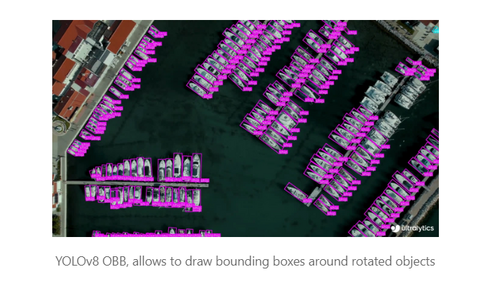

Slide 5
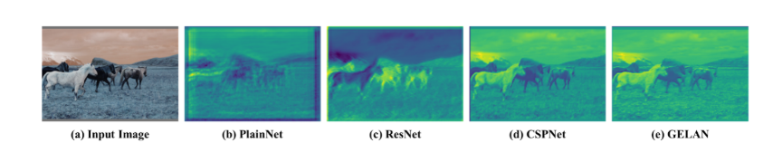
Advantages of YOLOv9
Improved architecture: YOLOv9 includes innovations such as Programmable Gradient Information (PGI) and Generalized Efficient Layer Fusion Network (GELAN). PGI helps prevent data loss when updating gradients, and GEALAN improves the performance of lightweight models, increasing their efficiency.
Innovative functions: The information bottleneck principle and reversible functions increase both the efficiency and accuracy of the model.

Slide 6
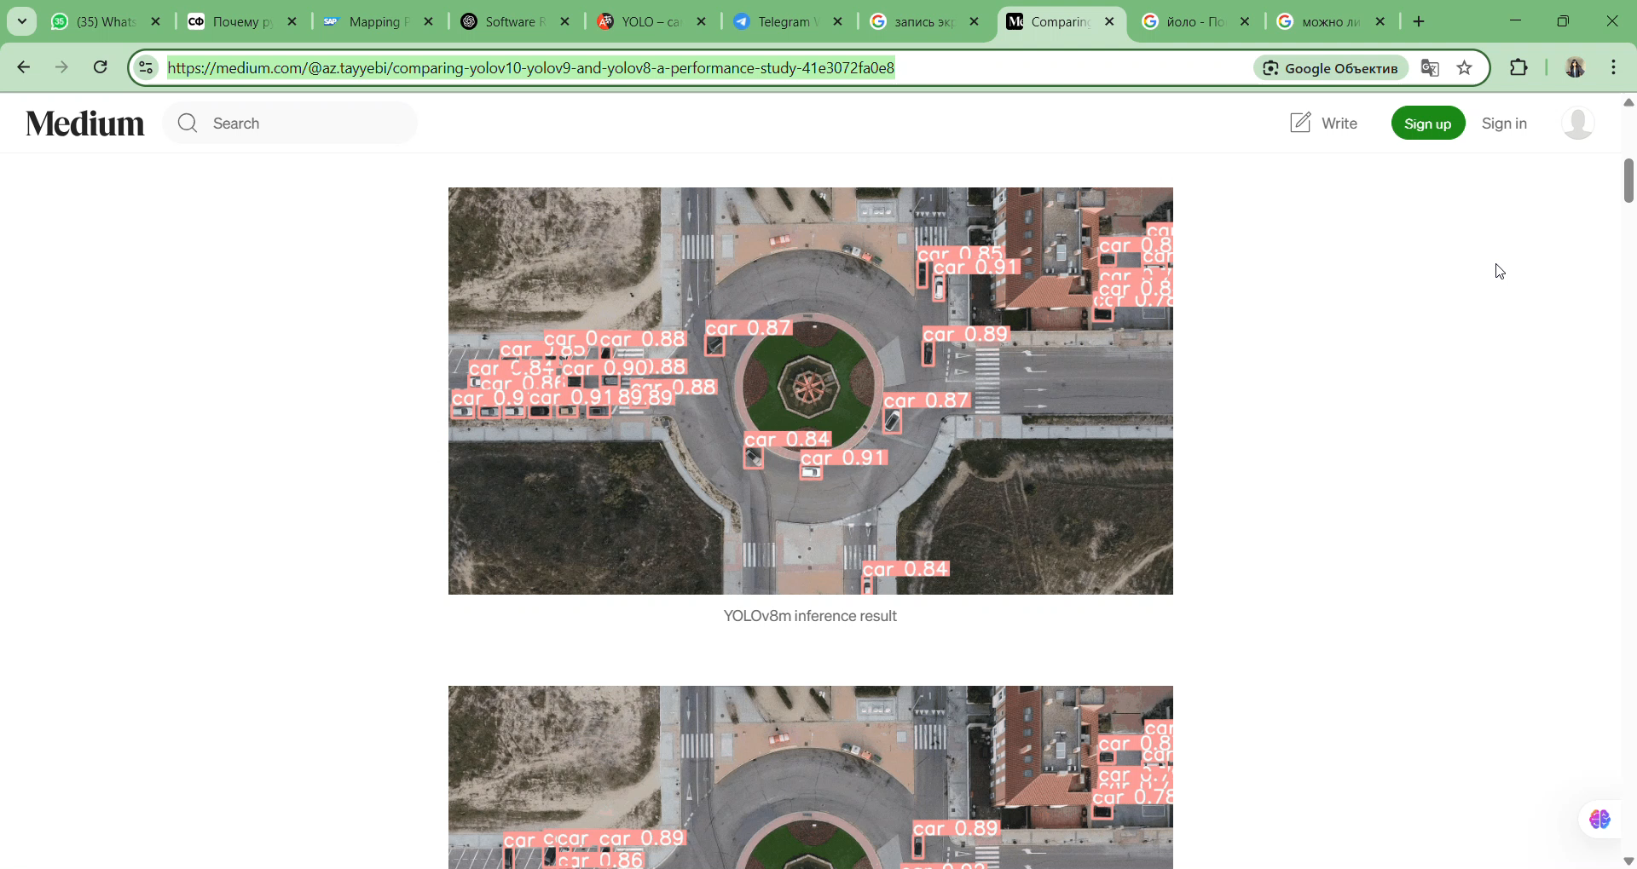
Video of the model output
To illustrate the differences in the performance of the models, a series of tests were conducted, during which the output results for different versions of YOLO were recorded: YOLOv8m, YOLOv9c and YOLOv10m. For this demonstration, videos taken from open sources on the Internet were used.

Slide 7
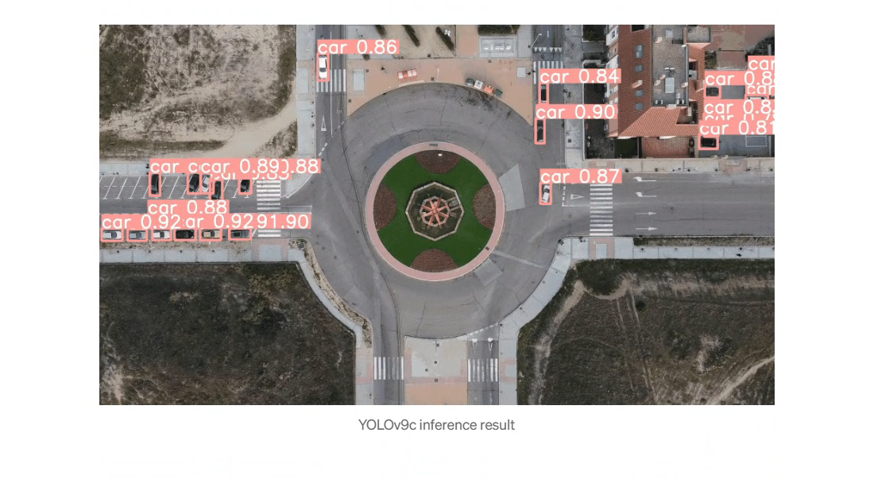

Slide 8
Conclusion
YOLOv9c outperformed YOLOv8m in correctly labeling an object that YOLOv8m misidentified, highlighting the optimizations in newer models. While YOLOv8 achieves higher recall by detecting more true positives, it also has a higher false positive rate, sometimes identifying non-existent objects. In contrast, YOLOv9 takes a more conservative approach, reducing false positives but increasing false negatives. With fine-tuning, YOLOv8m could potentially match or surpass YOLOv9c in accuracy.

